Slide 1





Developed by GAWM
BETA
Copyright © 2016 DigiPen (USA) Corp. and its owners. All rights reserved.

Slide 2

TEAM GAWM
Mohammad Amro – technical director
Shawn masters – design director
Zander kandalaft – producer
Brock lyons – product manager
Copyright © 2016 DigiPen (USA) Corp. and its owners. All rights reserved.

Slide 3
HIGH-CONCEPT
HYPER-DRIVE ACTION-TANK is a top-down 2d, INTER-GALACTIC, FLYING TANK, shoot ‘em up with A BLAZING RETRO FLAIR
Copyright © 2016 DigiPen (USA) Corp. and its owners. All rights reserved.

Slide 4
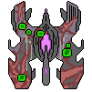




ENEMY TYPES
Copyright © 2016 DigiPen (USA) Corp. and its owners. All rights reserved.

Slide 5
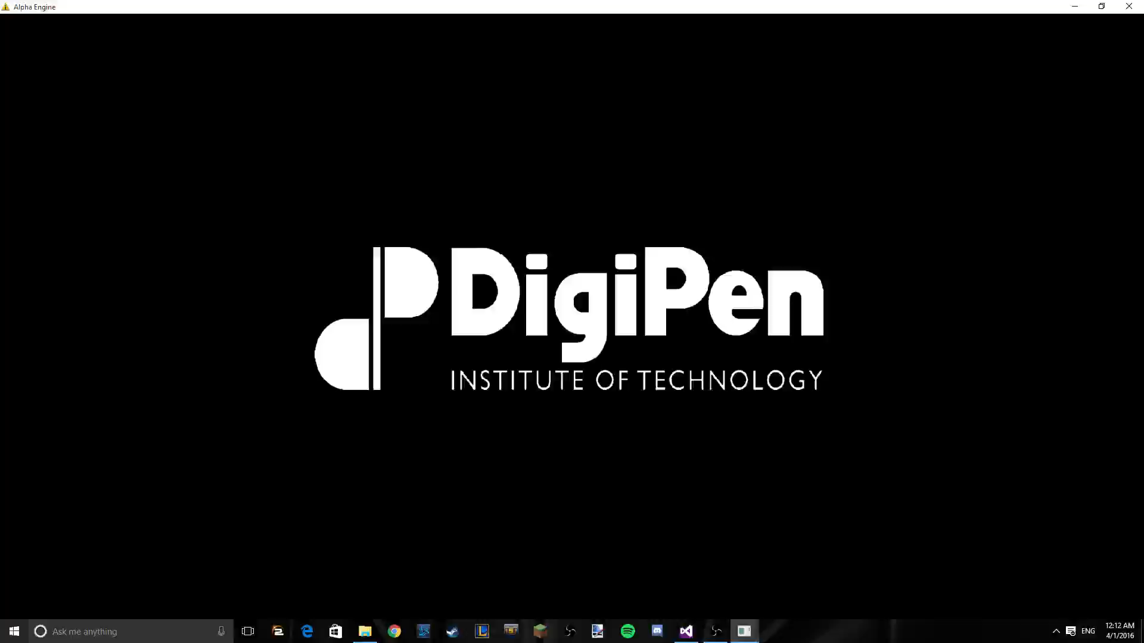
Credits Screen
Copyright © 2016 DigiPen (USA) Corp. and its owners. All rights reserved.

Slide 6
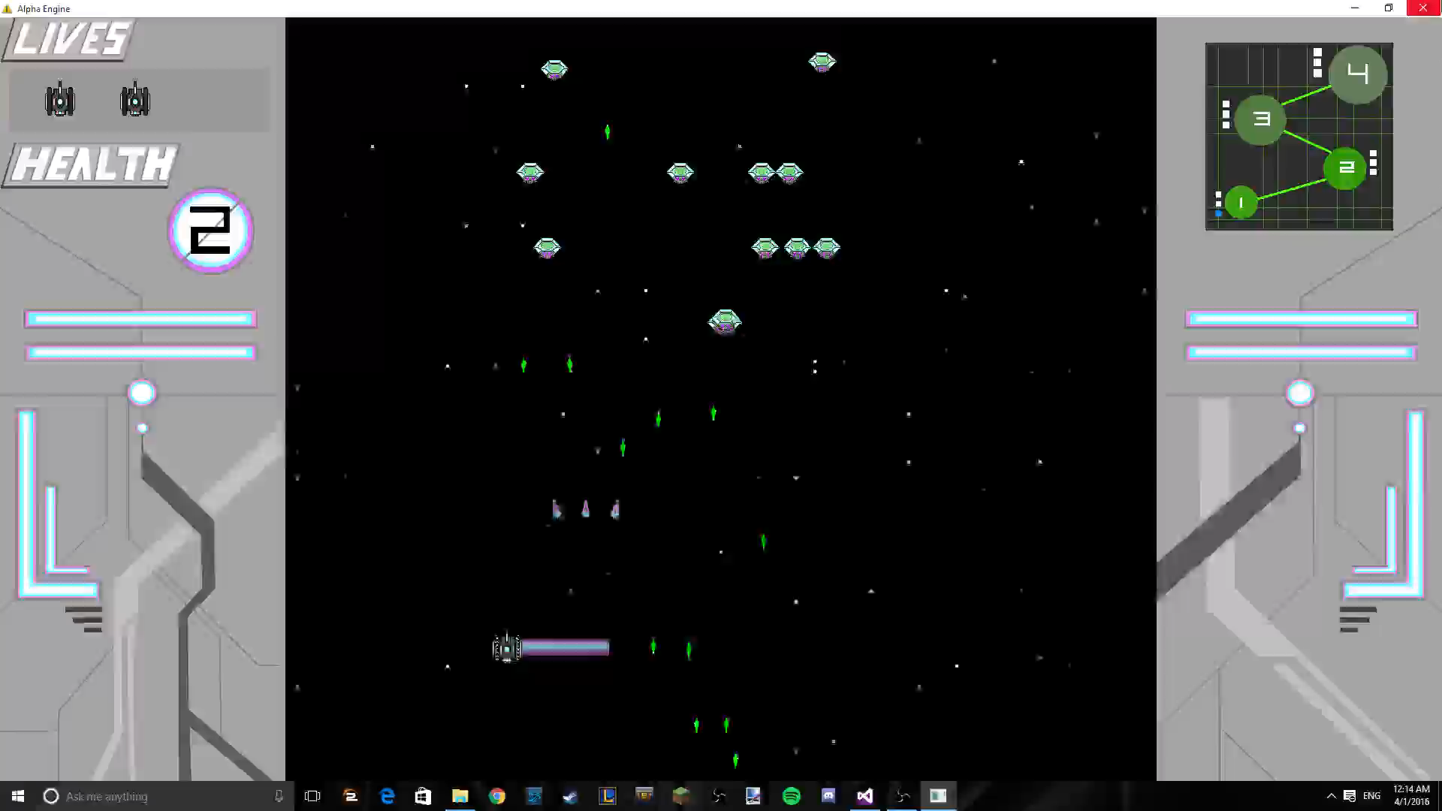
Shooting Variation
Copyright © 2016 DigiPen (USA) Corp. and its owners. All rights reserved.

Slide 7
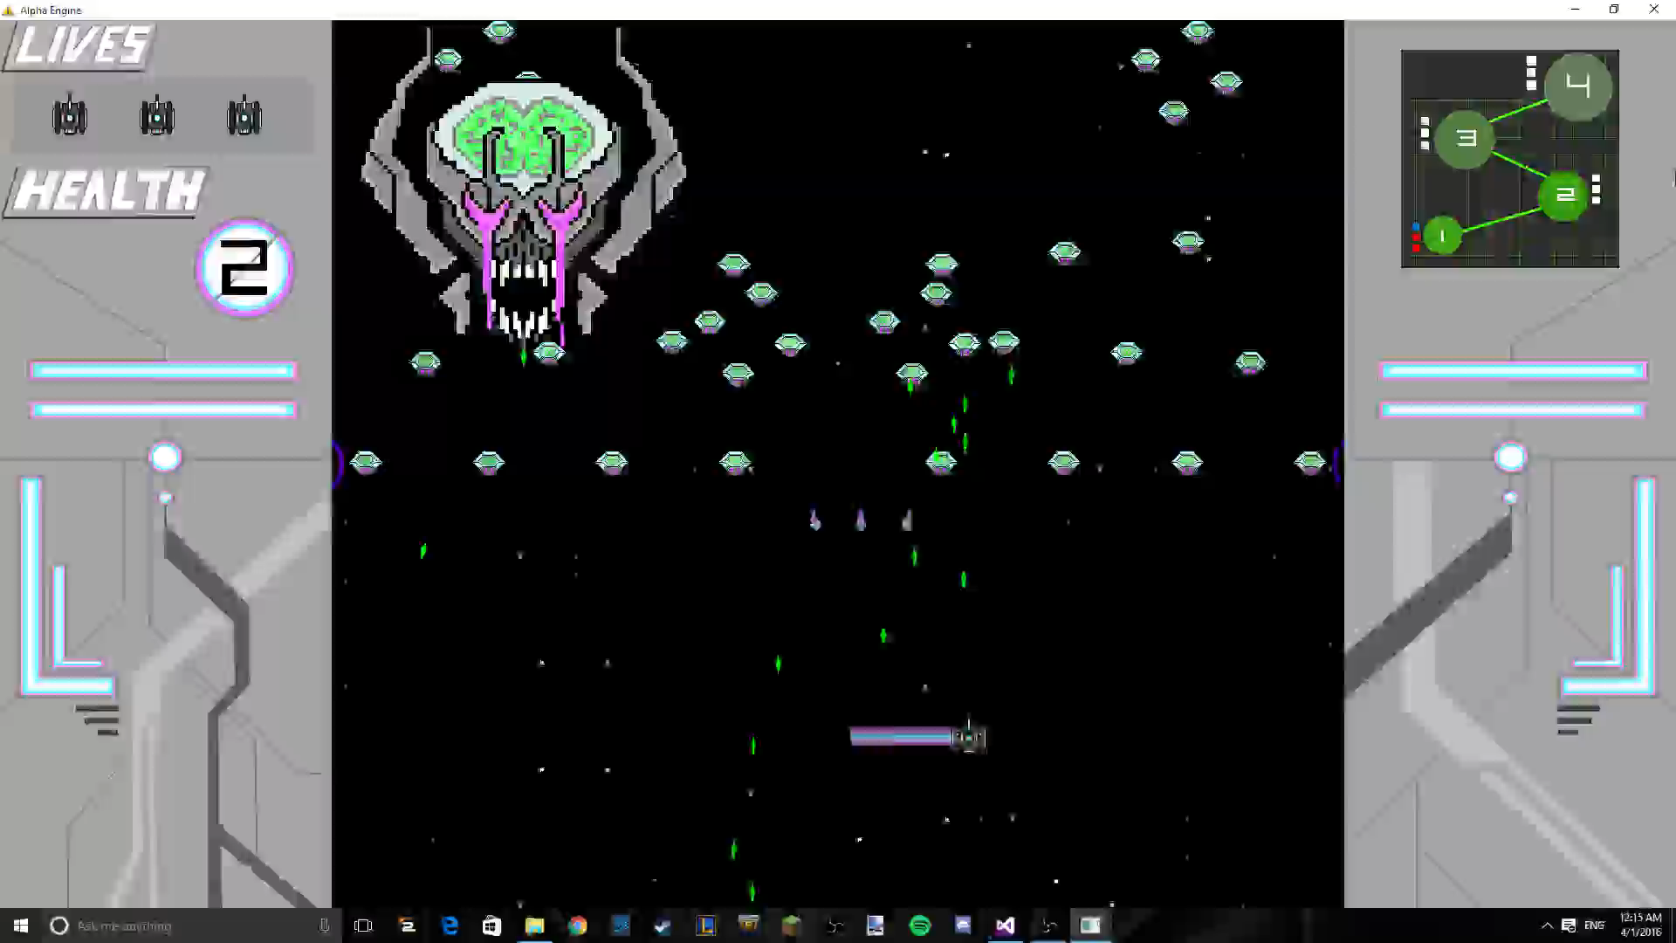
BOSS 1
Copyright © 2016 DigiPen (USA) Corp. and its owners. All rights reserved.

Slide 8
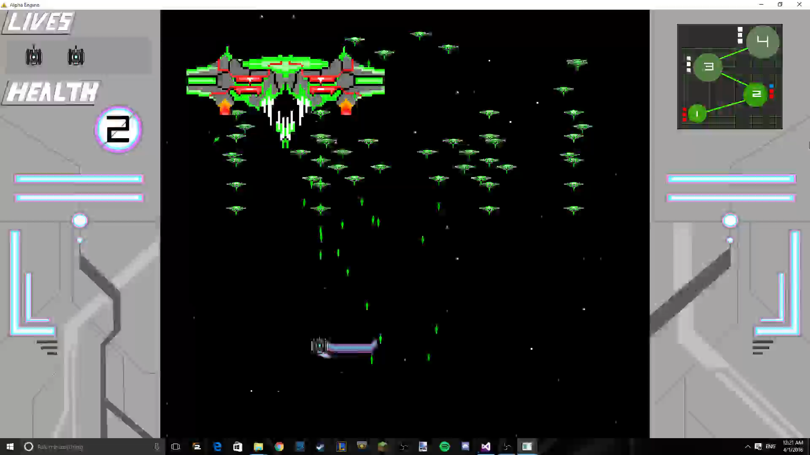
BOSS 2
Copyright © 2016 DigiPen (USA) Corp. and its owners. All rights reserved.

Slide 9
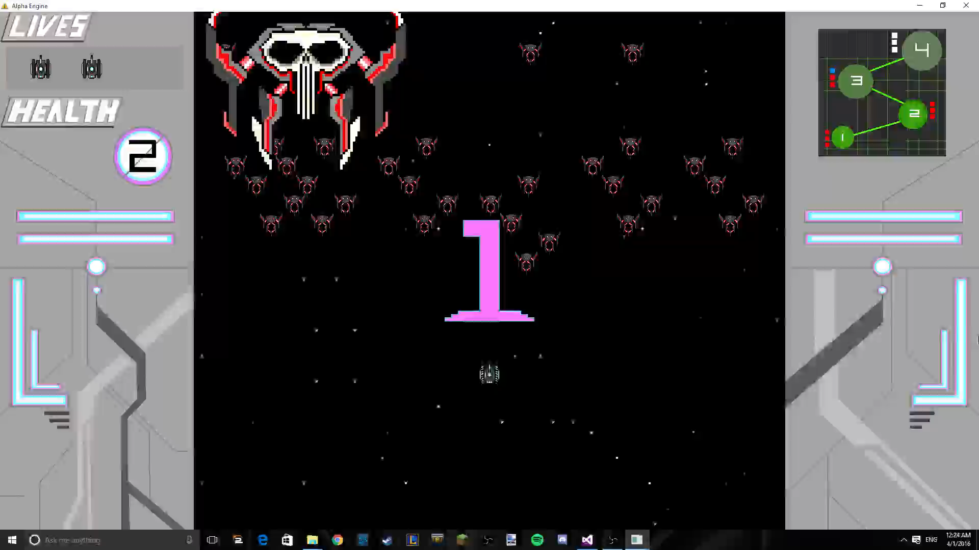
BOSS 3
Copyright © 2016 DigiPen (USA) Corp. and its owners. All rights reserved.

Slide 10
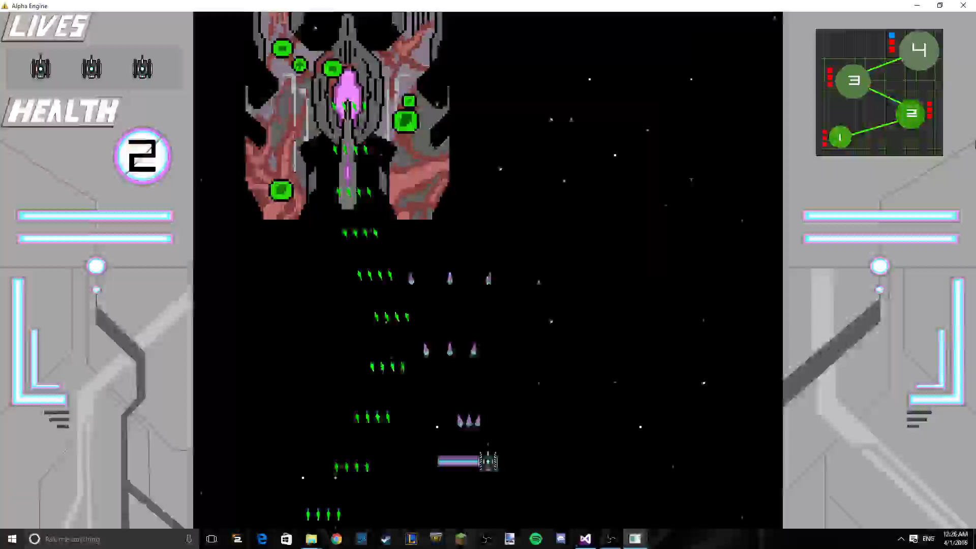
FINAL BOSS
Copyright © 2016 DigiPen (USA) Corp. and its owners. All rights reserved.

Slide 11
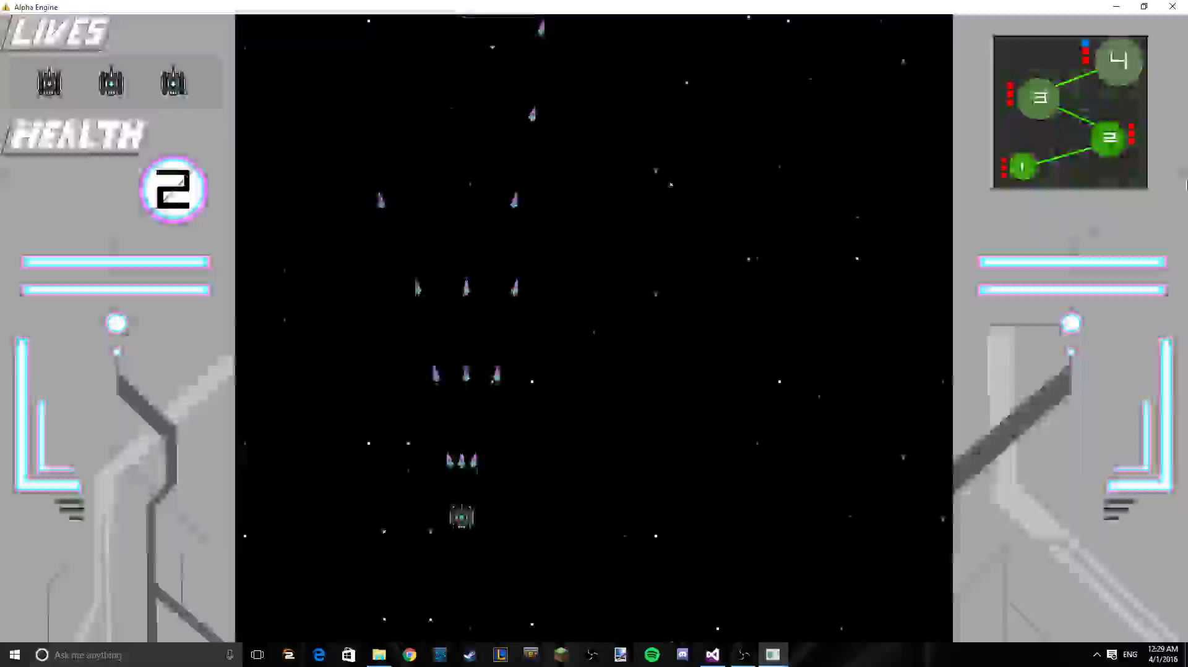
WIN SCREEN
Copyright © 2016 DigiPen (USA) Corp. and its owners. All rights reserved.

